Slide 1
Graph-based Movie Recommender System
using Sentiment, Emotion Analysis of BERT
Sentiment Graph
Emotion Graph
Graph Neural Network (GNN)
Presenter : Cheonsol Lee
Date : 2021.10.01
Notes:
안녕하세요.
BERT의 감성분석을 활용한 그래프 기반의 영화 추천시스템에 대한 연구를 말씀드리겠습니다.

Slide 2
1
Introduction
2
Related Work
3
Methodologies
INDEX
4
Experiments
5
Results
6
Conclusions

Slide 3
1. Introduction
Thank you

Slide 4


1. Introduction – Motivation
Industry of Recommender System
User experience(UX) is required for personalized marketing.
When watching the movies, UX may be expressed as Sentiment/Emotion data.
Movie Experience (MX)
Movie Experience(MX) is UX for watching the movies.
User’s psychological information -> Sentiment/Emotion
Rational basis
User’s feelings are reflected in the movie review.
There is a correlation between emotions about the movie reviews and satisfaction.
Emotional information can be used as personalized data.[1]
[1] The impact of emotions on the helpfulness of movie reviews (JART 2015)

Slide 5

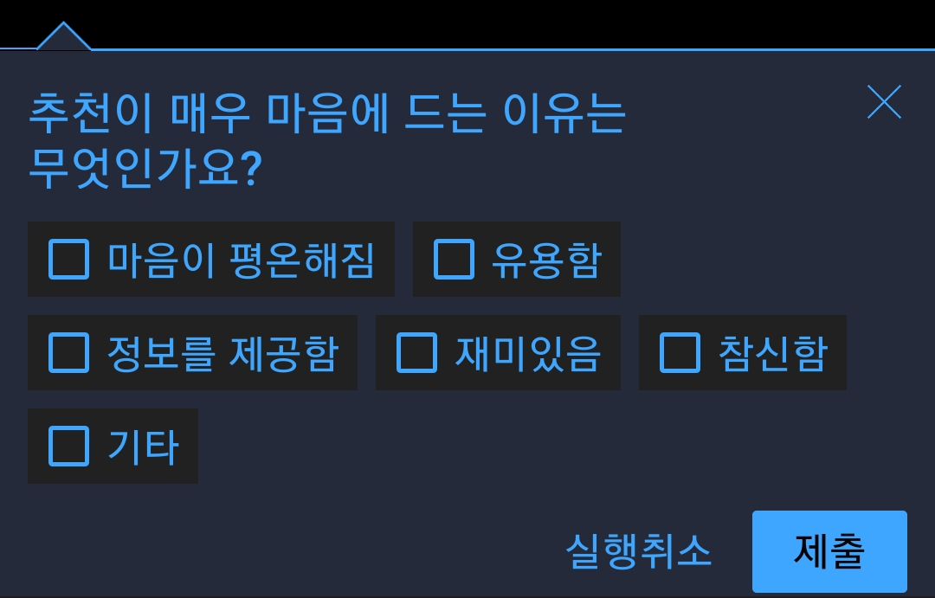
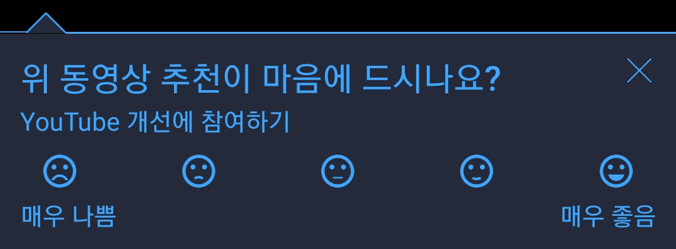
1. Introduction – Case of Sentiment/Emotion
Case of Sentiment/Emotion
YouTube Report for Personalized Recommendation
Data collection
Sentiment : 5-levels
Emotion : 6-levels
<Sentiment>
<Emotion>

Slide 6
1. Introduction – Research Question(RQ)
RQ1) How do you define Movie Experience(MX)?
Use sentiment/emotion as additional information that can’t be included in rating
RQ2) How do you express MX?
3 types of graphs : rating, sentiment, emotion
The graph reflects the relational information between users and items.
RQ3) Which model performs the best rating prediction?
GNN-based model : GCMC, IGMC, IMC-GAE

Slide 7
2. Reference
Thank you

Slide 8
2. Related Work (cont’d)
Sentiment Analysis
[1] The impact of emotions on the helpfulness of movie reviews (JART 2015)
There is a correlation between emotions about the movie reviews and satisfaction.
[2] Integrating Collaborative Filtering and Sentiment Analysis : A Rating Inference Approach (ECAI 06’ workshop)
Approach sentiment analysis with statistical techniques
[3] BERT 기반 감성분석을 이용한 추천시스템 (KCI 21')
Comparing Emotional Analysis with ML/DL Techniques and Presenting the Performance of BERT
Limitation : rating inference was only carried out, and explainable recommendation is not possible.
[4] Movie Recommendation System Using Sentiment Analysis From Microblogging Data (IEEE transactions on css 20’)
Hybrid RS from collaborative filtering(CF) and content-based filtering(CBF) along with sentiment analysis
[5] Using Affective Features from Media Content Metadata for Better Movie Recommendations (KDIR 20’)
Detect movie overviews’ implicit affective features like emotion and sentiment.
Strength: reflect dynamic information like user’s emotion and sentiment

Slide 9
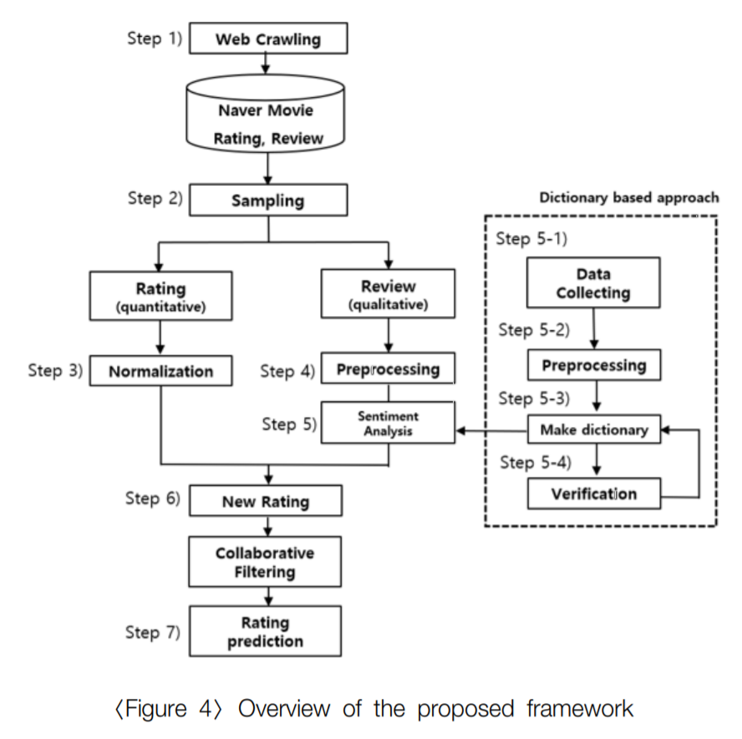
2. Related Work
Sentiment Analysis
[6] How to improve the accuracy of recommendation systems: Combining ratings and review texts sentiment scores. (JIIS 2019)
Emotion Analysis
[7] Tensor-based tag emotion aware recommendation with probabilistic ranking. (KSII 2019)
[8] Item recommendation using tag emotion in social cataloging services. (ScienceDirect 2017)

Slide 10
3. Methodologies
Thank you

Slide 11
3. Framework
Web Crawling
Movie Database
Sampling
Review
Rating
Review
BERT
BERT
Normalization
Sentiment / Emotion
Sentiment
Emotion
Multi-layer embedding
Graph Model
Rating Prediction

Slide 12


3. Framework
M | R | U
0 | 3.5 | 1
1 | 4.7 | 1
2 | 1.3 | 2
Sum of relation values
Multi-layer Graph
(Rating graph)
M | S | U
0 | 1 | 1
1 | 3 | 1
2 | 2 | 2
Graph
model
(Sentiment graph)
[Predicted Rating]
Metric: RMSE/MAE
[Baseline]
Traditional: CF, SVD, NCF
Graph: GCMC, IGMC, IMC-GAE
M | B | U
0 | 1 | 1
1 | 2 | 1
2 | 5 | 2
Ablation Study
(Emotion graph)
Notes:
그래프를 단순 합으로 결합
Multi-layer로 구성하여 GNN 학습

Slide 13
4. Experiments
Thank you

Slide 14
4. Experiments – dataset
Dataset
Period : 1914.06.01 ~ 2020.10.31
Link : https://www.kaggle.com/stefanoleone992/rotten-tomatoes-movies-and-critic-reviews-dataset
Data
File name | Dimension | Columns
Movie data | (17713, 22) | 'rotten_tomatoes_link', 'movie_title', 'movie_info', 'critics_consensus', 'content_rating', 'genres', 'directors', 'authors', 'actors', 'original_release_date', 'streaming_release_date', 'runtime', 'production_company', 'tomatometer_status', 'tomatometer_rating', 'tomatometer_count', 'audience_status', 'audience_rating', 'audience_count', 'tomatometer_top_critics_count', 'tomatometer_fresh_critics_count', 'tomatometer_rotten_critics_count'
Review data | (1048576, 8) | rotten_tomatoes_link, critic_name, top_critic, publisher_name, review_type, review_score, review_date, review_content
Rating | Review | Amount | Rate
O | O | 758,709 | 67%
X | O | 305,502 | 27%
O | X | 65,372 | 5%
X | X | 434 | 0.03%

Slide 15
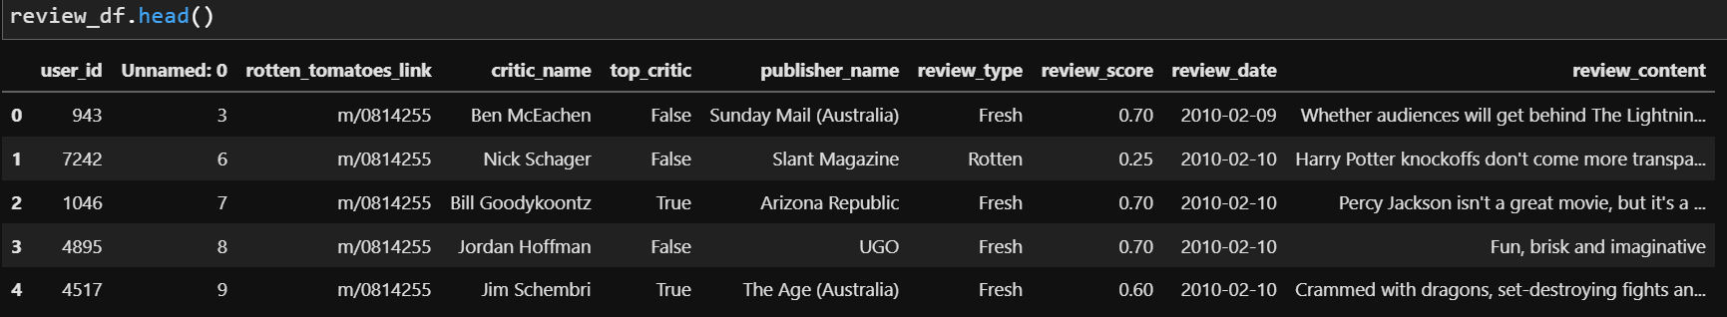
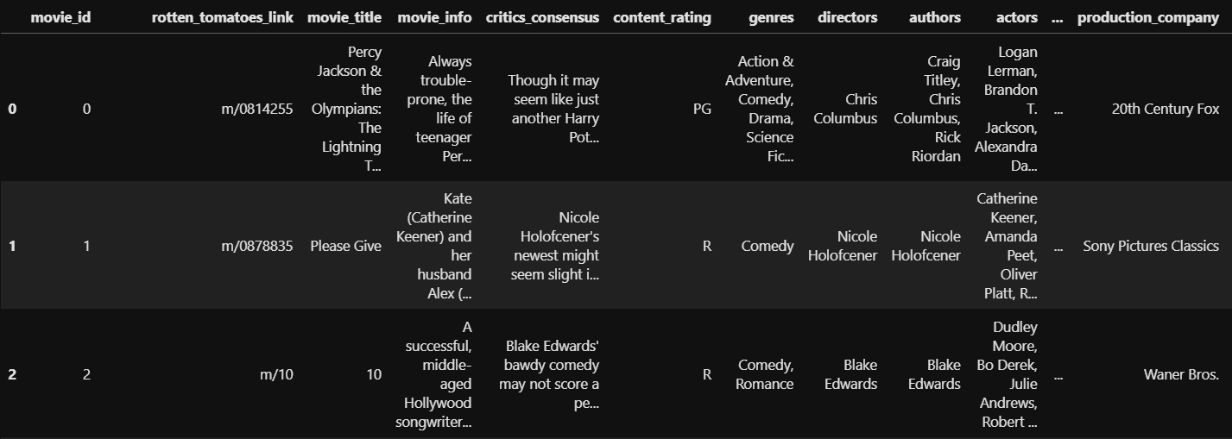
4. Experiments – dataset
Dataset
Rating matrix
Group : critic_name, top_critic, publisher_name
The number of users : 9,794
Movie matrix
The number of movies: 17,614

Slide 16
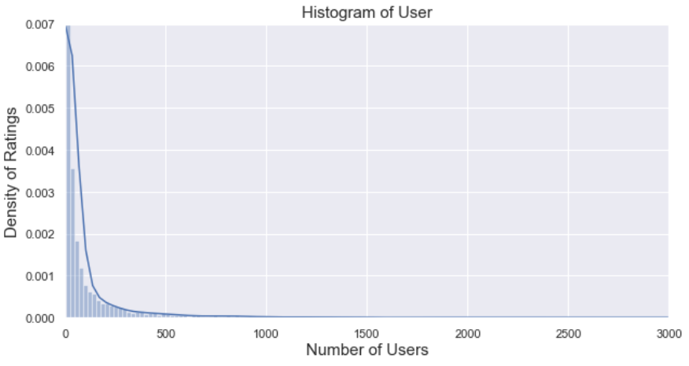
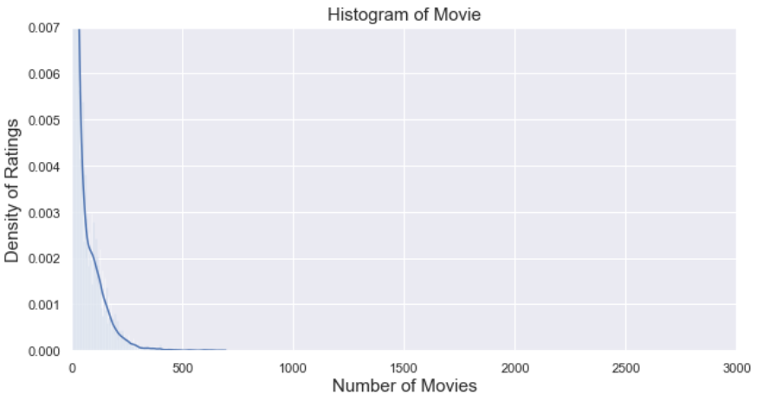
4. Experiments – dataset
Histogram
Group: User, Movie
Range
X-axis : 0 ~ 3,000
Y-axis : 0 ~ 500
Bins : 100
Range | User | Movie
Total | 9,794 | 17,614
< 3 | 3,552 (36%) | 993 (6%)
< 5 | 4,653 (48%) | 2,892 (16%)
>= 100 | 1,343 (14%) | 2,490 (14%)
>= 500 | 345 (4%) | 13 (0%)
Reviews >= 100
<User>
<Movie>

Slide 17
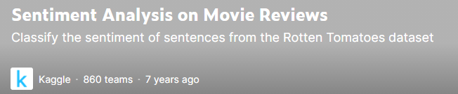
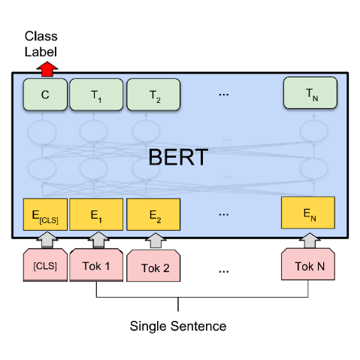
4. Experiments – dataset
BERT
Learning data for sentiment analysis
The sentiment labels
0 – Negative
1 – Somewhat Negative
2 – Neutral
3 – Somewhat Positive
4 - Positive
Review data
Result
M | S | U
0 | 1 | 1
1 | 3 | 1
2 | 2 | 2
Uma Thurman as Medusa, the gorgon with a coiffure of writhing snakes and stone-inducing hypnotic gaze is one of the highlights of this bewitching fantasy
Sentiment value
(Sentiment graph)

Slide 18
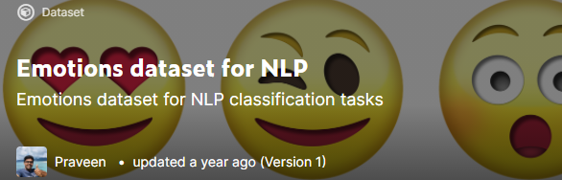
4. Experiments – dataset
BERT
Learning data for emotion analysis
The sentiment labels
0 – anger
1 – fear
2 – joy
3 – love
4 – sadness
5 - surprise
Review data
Result
M | S | U
0 | 1 | 1
1 | 3 | 1
2 | 2 | 2
Uma Thurman as Medusa, the gorgon with a coiffure of writhing snakes and stone-inducing hypnotic gaze is one of the highlights of this bewitching fantasy
Emotion value
(Sentiment graph)

Slide 19
4. Experimental Table
Result
Graph type : Rating, Sentiment, Emotion + Meta informaion
Data : 60%(rating, review)
Ideal result
Type | Method | RMSE/MAE | Data
Baselines | CF MF: SVD, SVD++ FM NCF | Low | Rating
Graph (in general) | GCMC IGMC IMC-GAE | Middle | Rating
Graph (our model) | GCMC + “novelty” | High | Rating
 |  |  | Rating + Sentiment
 |  |  | Rating + Emotion
 |  |  | Rating + Sentiment + Emotion

Slide 20
5. Results
Thank you

Slide 21
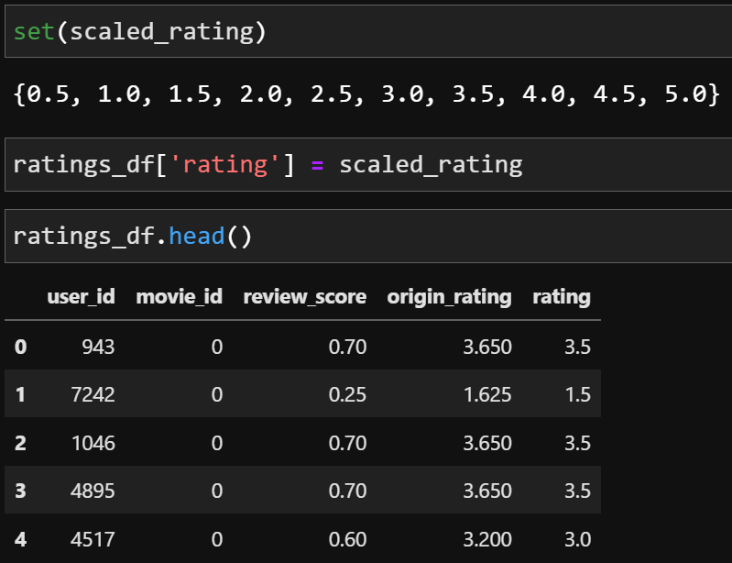
5. Results – GNN
Dataset
train/test 7:3
GCMC
Rating + Feature(X)
Rating + Feature(O: User, Movie) : 예정
Surprise
k=10
CF(user-based, item-based), MF(SVD, SVD++)
< Rating Scaling >
CF (User-based) | CF (Item-based) | SVD++ | SVD | GCMC (Feature X) | GCMC (Feature O)
0.6984 | 0.8396 | 0.7173 | 0.7189 | 0.8010 | -

Slide 22
6. Conclusions
Thank you

Slide 23
6. Conclusions
Movie Experience(MX) can be used for personalized recommendations.
The graph reflects the relational information between users and items.
GNN-based recommendation is better than traditional methods.
Recommendations reflecting sentiment/emotion data improve rating prediction.

Slide 24
To do
Thank you

Slide 25
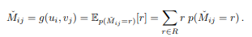
To do
GCMC 점수 계산
Regression으로 계산 후 rmse로 score 계산
Ex) (1*0.1) + (2*0.2) + (3*0.3) + (4*0.1) + (5*0.3) = 3.3

Slide 26
To do
GCMC 결과 뽑기
Feature (O)
Sum of relation
Multi-layer embedding
Edge type : rating, sentiment, emotion
Edge feature : rating(label), feature(sentiment, emotion)
합치기
Encoding 전 : 병합 후 입력 (Sum of relation)
Encoding 후 : 3개의 인코딩 결과를 병합
Decoding 후 : 3개 결과 병합
Q&A
Bigcomp : 성능 결과 어디까지 제출? Full paper (6장)
Train/Valid/Test set을 동일하게 해야 하는지? K-fold, 여러 번 테스트? 동일한 데이터를 여러 번 뽑아서 좋은 결과로 쓰기 (ex- 5번 정도 데이터셋 뽑기)
Score 계산 : RMSE(기존 진행), MPE(추가 진행)

Slide 27
To do
IEEE Bigcomp 2022
MX 개념 제안 : 개념은 없어도 emotion, sentiment를 동시에 고려하는 논문으로 introduction 채우기
Emotion, sentiment에 대한 정확한 정의? 혼동한 논문들 많음(논문 찾기)
Bigcomp를 Journal에 reference하기
Journal
IEEE Transactions on Consumer Electronics
IEEE Transactions on Social ~~~~(기준형님께 문의)

Slide 28
To do
IEEE Bigcomp 2022
동희:
relation이 sparse한 경우에는 gcmc가 cf보다 좋은 성능을 낼 것이다.
Rating을 numerical하지 않고 discrete한 개념으로 접근했는데, 인접행렬에 binary가 아닌 ‘연속 값’으로 넣는게 합리적이다.
r을 rating(1~5) + “sentiment(1~5), emotion(1~6, categorical)” 3개의 인접행렬
r을 rating(1~5) + “sentiment(1~5)” 2개의 인접행렬
R에 따른 결과가 다름 : regression이 되긴 했으나 layer는 classification이다.
모델
Classification 확률 * 평점 => Regression

Slide 29
To do
IEEE Bigcomp 2022
동희:
relation이 sparse한 경우에는 gcmc가 cf보다 좋은 성능을 낼 것이다.
왜??
message passing으로 전체를 보는 것이 아니라 연결된 것만 고려함
전체 구조를 보는 것이 아니라 그래프 자체의 detail한 feature 정보를 고려함
Sampling?
Graph에 node, edge를 한번에 넣지 않고 서브graph(mini-batch)를 뽑아서 학습함.

Slide 30
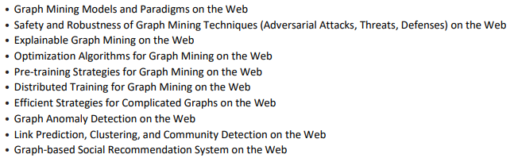

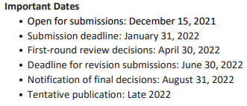
To do
IEEE BigComp 2022 – short paper (21.10.14)
ACM Transactions on the Web(22.01.31)
Special Issue on Advanced Graph Mining on the Web

Slide 31
Thank you
Thank you

Slide 32
Appendix
Thank you

Slide 33
3. Framework - Methodology
M | R | U
0 | 0.5 | 1
1 | 0.7 | 1
2 | 0.3 | 2
Sum of relation values
Multi-layer Graph
(Rating graph)
M | S | U
0 | 1 | 1
1 | 3 | 1
2 | 2 | 2
Graph
model
(Sentiment graph)
[Predicted Rating]
Metric: RMSE/MAE
[Baseline]
Traditional: CF, SVD, NCF
Graph: NGCF, GCN, GAT, GraphSAGE
M | B | U
0 | 1 | 1
1 | 2 | 1
2 | 5 | 2
Ablation Study
(Emotion graph)
Notes:
그래프를 단순 합으로 결합
Multi-layer로 구성하여 GNN 학습

Slide 34
3. Result Table
Result
Graph type : Rating, Sentiment, Emotion
Data : 60%(rating, review)
Ideal result
Type | Method | F1-score | Data
Baselines | CF MF FM NCF | Low | Rating
Graph (in general) | GCN (GCMC) GAT GraphSAGE Graphormer | Middle | Rating
Graph (our model) | GNN + “novelty” | High | Rating
 |  |  | Rating + Sentiment
 |  |  | Rating + Emotion
 |  |  | Rating + Sentiment + Emotion

Slide 35
1. Introduction – Research Question(RQ)
RQ1) How do you define Movie Experience(MX)?
Use sentiment/emotion as additional information that can’t be included in rating
RQ2) How do you express MX?
3 types of graphs : rating, sentiment, emotion
The graph reflects the relational information between users and items.
RQ3) Which model performs the best rating prediction?
GNN-based model : GCMC, IGMC, IMC-GAE

Slide 36
4. GNN
GNN Model
Graph Convolutional Matrix Completion (GCMC) [KDD 2018] (세팅 완료, 데이터 적용 중)
Inductive Matrix Completion Based on Graph Neural Networks (IGMC) [ICLR 2020] (예정)
Inductive Matrix Completion Using Graph Autoencoder (IMC-GAE) [CIKM 2021] (세팅 완료, 데이터 적용 중)

Slide 37
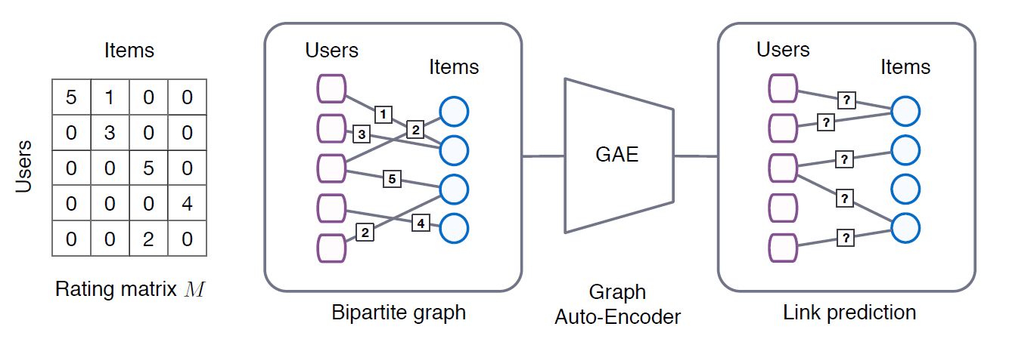
4. GCMC
Graph Convolutional Matrix Completion [KDD 2018]
Rating
Node features
GCN

Slide 38
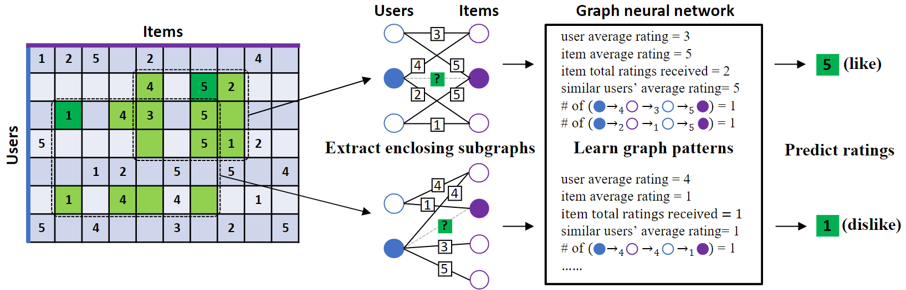
4. IGMC
Inductive Matrix Completion Based on Graph Neural Networks (IGMC) [ICLR 2020]
Rating

Slide 39
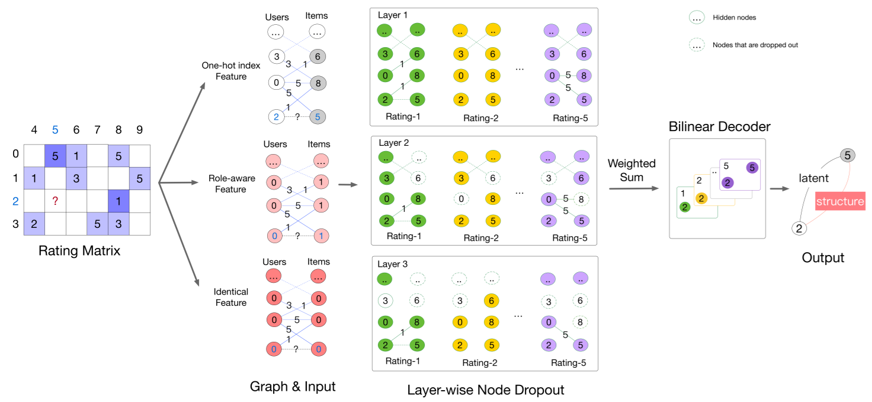
4. IMC-GAE
Inductive Matrix Completion Using Graph Autoencoder (IMC-GAE) [CIKM 2021]
Rating

